Slide 1
USED CAR PRICE PREDICTION
Presented By
Aamina Ruvaida

Slide 2
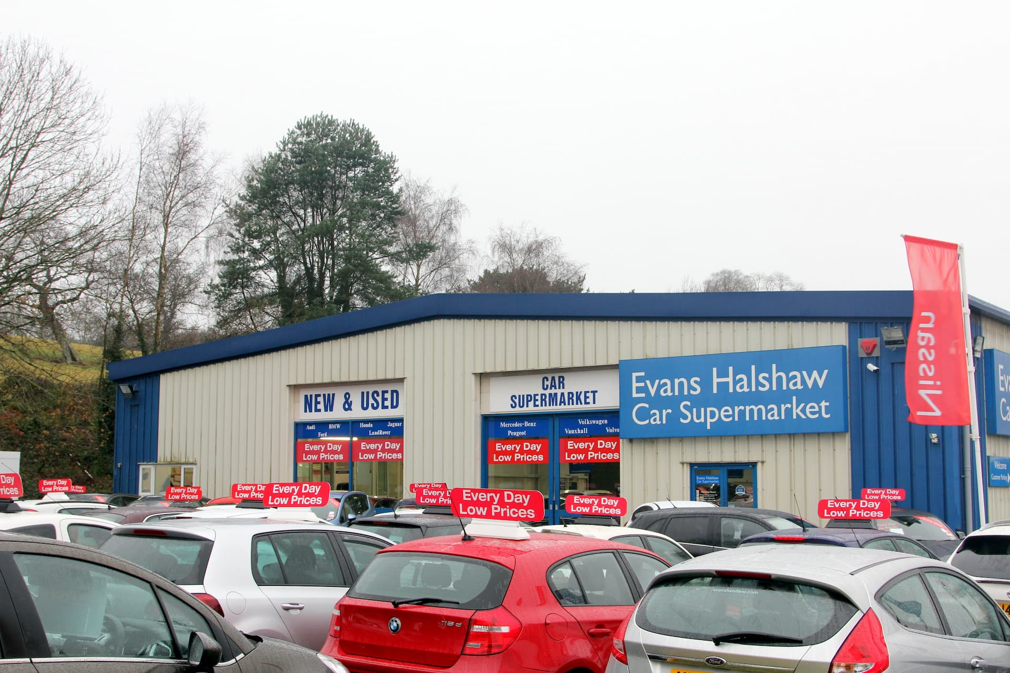

Slide 3
Agenda
Introduction
Problem Statement
Problem Understanding
What is Used Cars and its Benefits
Exploratory Data Analysis
Data Visualization
Model Building
Hyper Parameter Tuning
Predicting the Car Price from Final Model
Saving the Model.

Slide 4
Introduction
Predicting a used car price is crucial task, the price of a car depends on various factor, most of the time all the factors information will not be mentioned while selling the cars.
Cars price depends on the fuel engine, the car model, the origin location of the manufacture, its fuel type whether it consumes petrol or diesel. It also depends on Engine type, whether the car is manual or automatic. The fuel car consumes per km. The colour of the car, the seats, number of door, the weight of the car, We also investigate if the car met any serious accident. Car insurance and other several factor we tends to see when we think to buy a car. By analysis of all the factor the car price is predicted.
In this project, we predicted the car price based on some factor provided the car Dekho site.

Slide 5
PROBLEM STATEMENT
With the covid 19 impact in the market, we have seen lot of changes in the car market. Now some cars are in demand hence making them costly and some are not in demand hence cheaper. One of our clients works with small traders, who sell used cars. With the change in market due to covid 19 impact, our client is facing problems with their previous car price valuation machine learning models. So, they are looking for new machine learning models from new data. We have to make car price valuation model.
Business goal: The main aim of this project is to predict the price of used car based on various features. Machine Learning is a field of technology developing with immense abilities and applications in automating tasks. So, we will deploy an ML model for car selling price prediction and analysis. This kind of system becomes handy for many people. This model will provide the approximate selling price for the car based on different features like fuel type, transmission, price, weight, running in kms, engine displacement, milage etc and this model will help the client to understand the price of used cars.

Slide 6

Problem Understanding
Car Price Prediction is an interesting task, we predict based on analysis of various factor using the machine learning model. This helps the small traders to predict the car price. Who used to sell the car.
This helps the both buyer and seller, This model will help to understand the current car market trend and according to that they can predict the car price.
From the problem statement we came to know that it is a regression problem, since our target variable is “car price” and it is a continuous. So, we will use the regression algorithm to predict the car price.
Used Cars

Slide 7
What is Used Car and its Benefits?
A used car, a pre-owned vehicle, or a second-hand car, is a vehicle that has previously had one or more retail owners. Used cars are sold through a variety of outlets, including franchise and independent car dealers, rental car companies, buy here pay here dealerships, leasing offices, auctions, and private party sales. Some car retailers offer "no-haggle prices," "certified" used cars, and extended service plans or warranties.
Used car pricing reports typically produce three forms of the pricing information.
Dealer or retail price is the price expected to pay if buying from a licensed new-car or used-car dealer.
Dealer trade-in price or wholesale price is the price a shopper should expect to receive from a dealer if trading in a car. This is also the price that a dealer will typically pay for a car at a dealer wholesale auction.
Private-party price is the price expected to pay if buying from an individual. A private-party seller is hoping to get more money than they would with a trade-in to a dealer. A private-party buyer is hoping to pay less than the dealer retail price.

Slide 8
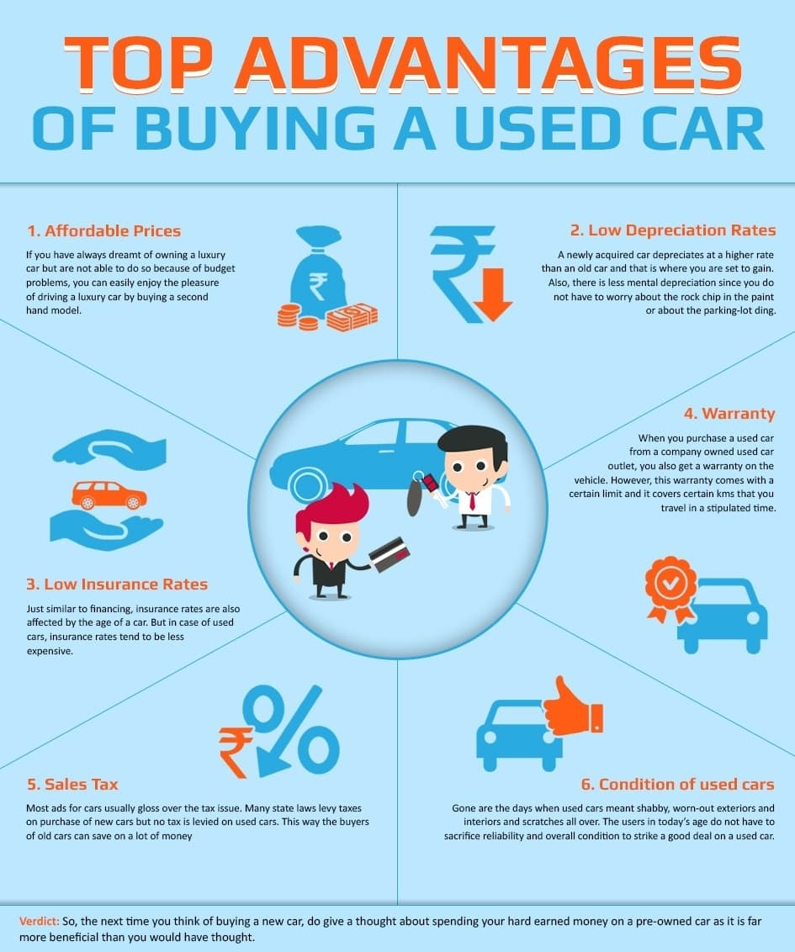
Benefits of buying Used Car
Affordable Price
Low Depreciation Rates
Low Insurance Rates
Warranty
Sales Tax
Condition of used car
Used cars have the features that we want
Save Money

Slide 9
Exploratory Data Analysis (EDA)
Importing the necessary Libraries and importing the data set in the form of a data frame.
Checking the unique value, its shape, data info, data description, data types.
Checking the null values, in our data set there is no null value present.
Used a various visualization plot like distribution plot, regression plot, bar plot, box plot, kde plot, stripplot, scatter plot to understand the data.
In the car model, we extracted the manufacturing year. From that we came to know the age of car.
We checked the outliers and removed the outliers using the zscore method.
We checked the skewness, removed the skewness using PowerTransformation.
We checked the variation inflation factor, in our data there is no multicollinearity exist.
We build the various Machine Learning model to make a better car price prediction.

Slide 10
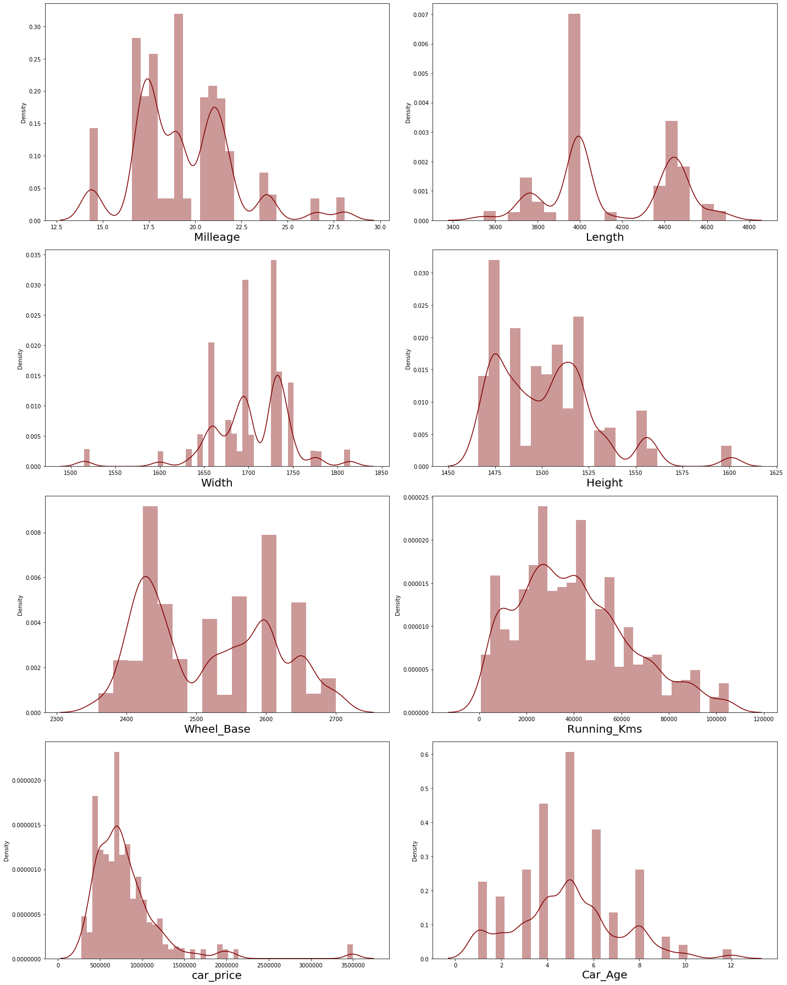
Visualization
In the above Distribution plot we see the data are not normally distribution, Car price is some what normally distributed. There is a skewness present in the data.

Slide 11
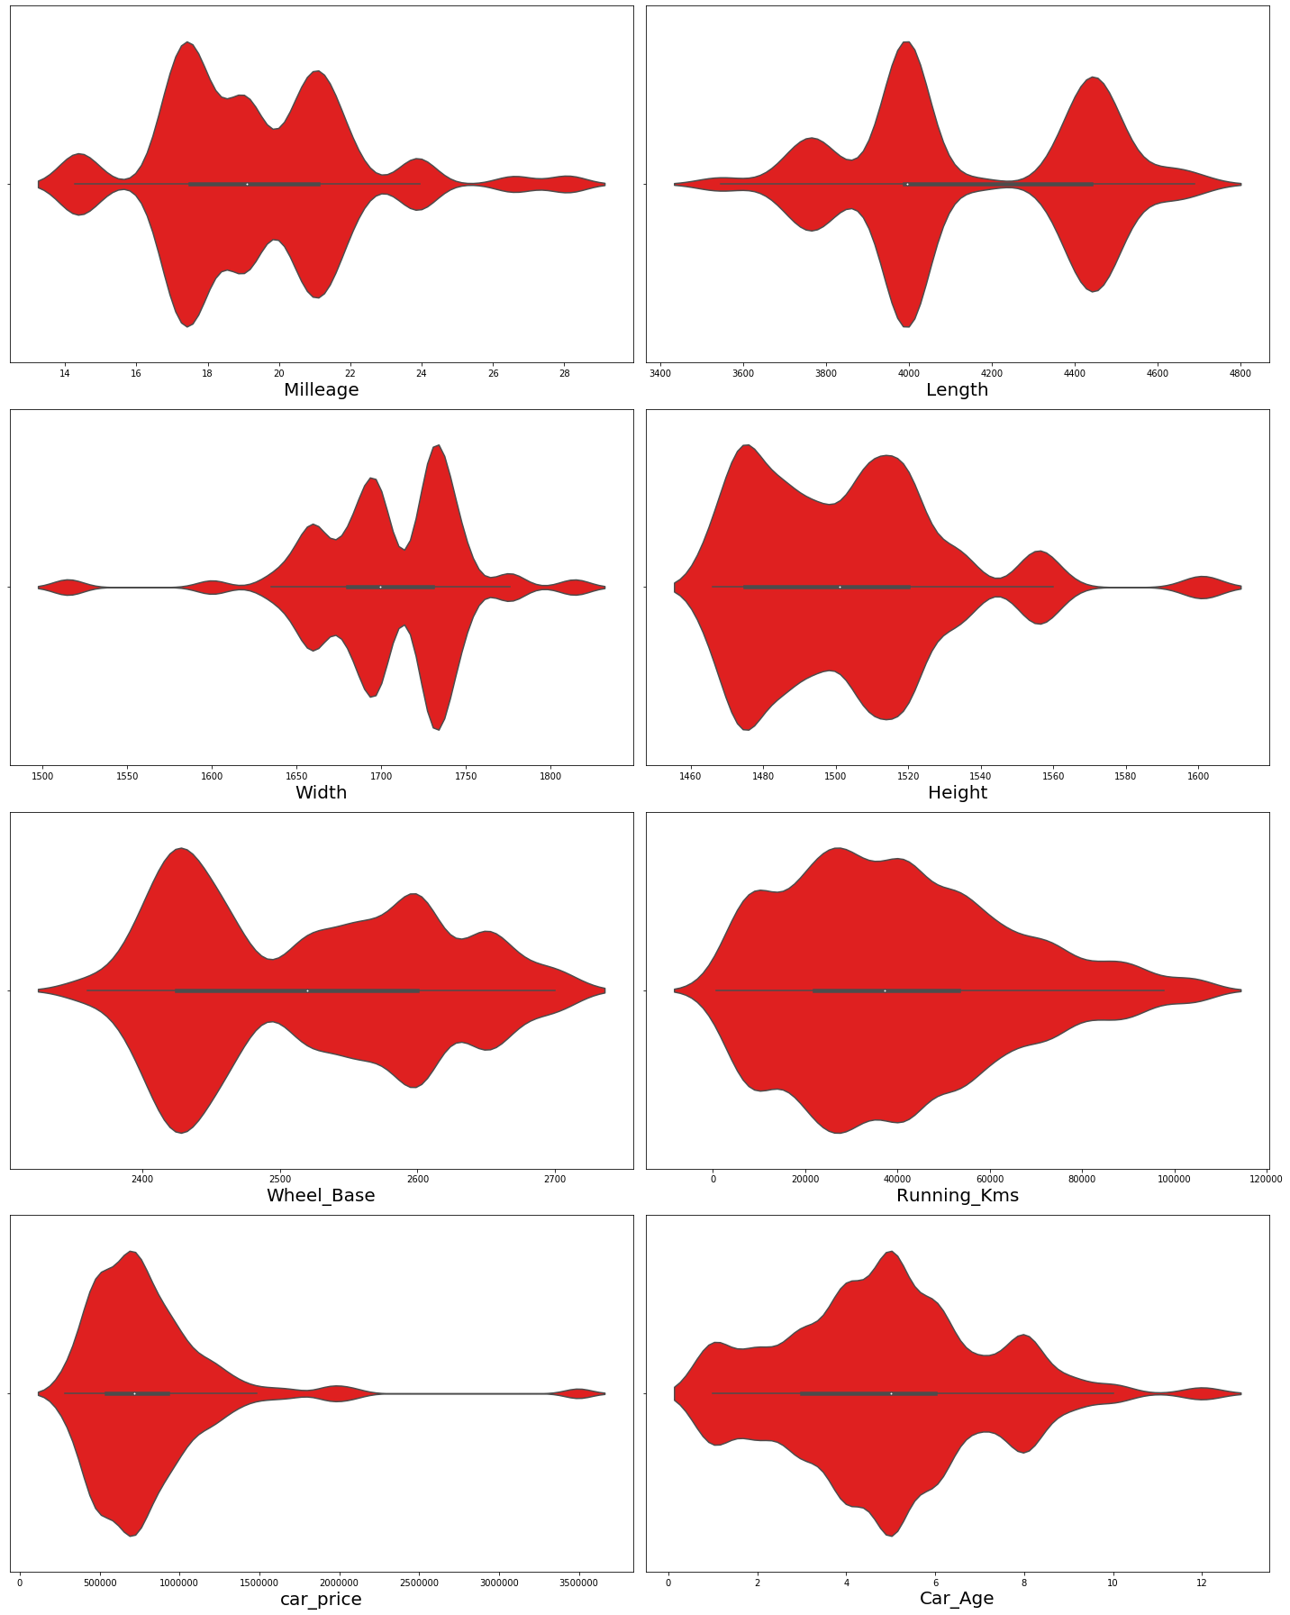
In the violin plot we see the Milleage 18-22 is high, in Length the range 4000 is high, in Width the range 1700 to 1750 is high, In height the range 1400 to 1500 there is a high count, the car price 500000 to 100000 count is high.

Slide 12
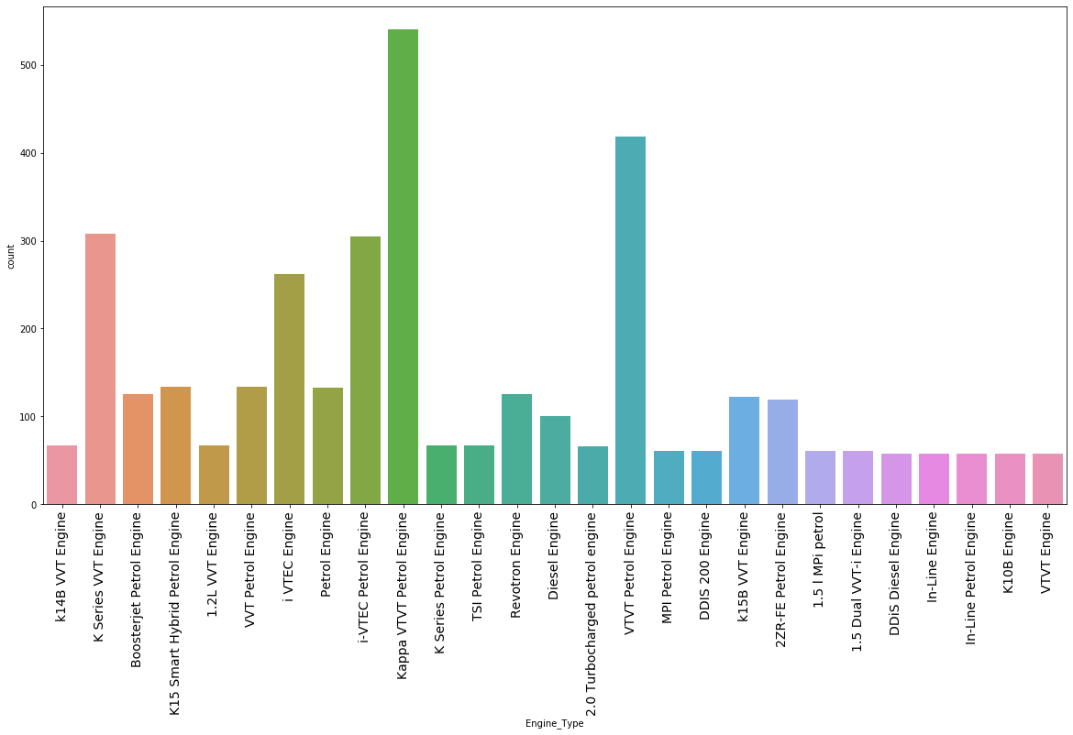
Visualizing the count of Engine Type

Slide 13
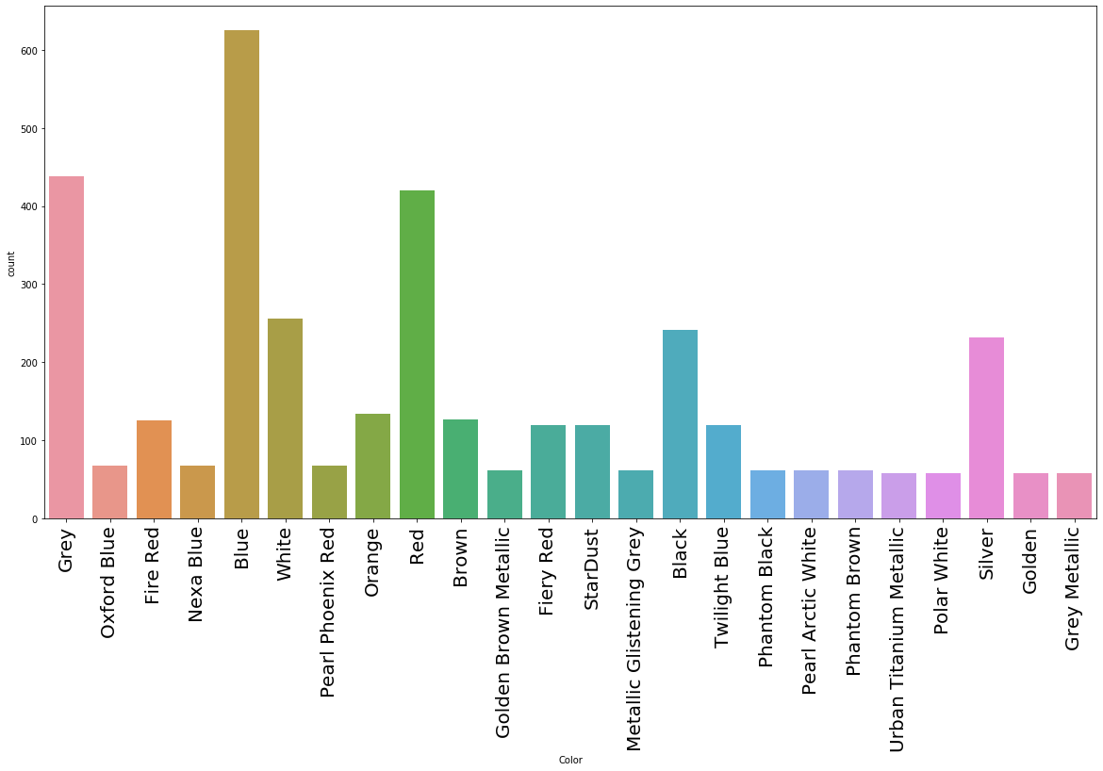
Visualizing the Count of Color
We see that Blue color car count is high as compare to other color’s car

Slide 14
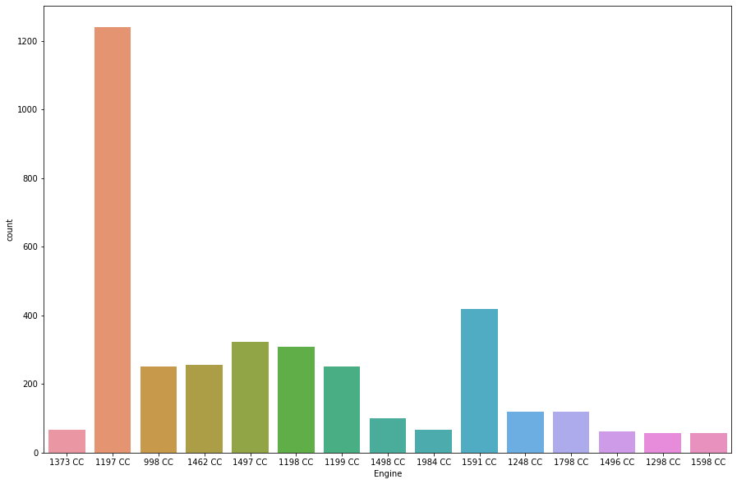
Visualizing the count of Engine
In Engine, 1197 CC Engine count is high, it shows that majority of people using the 1197CC Engine.

Slide 15
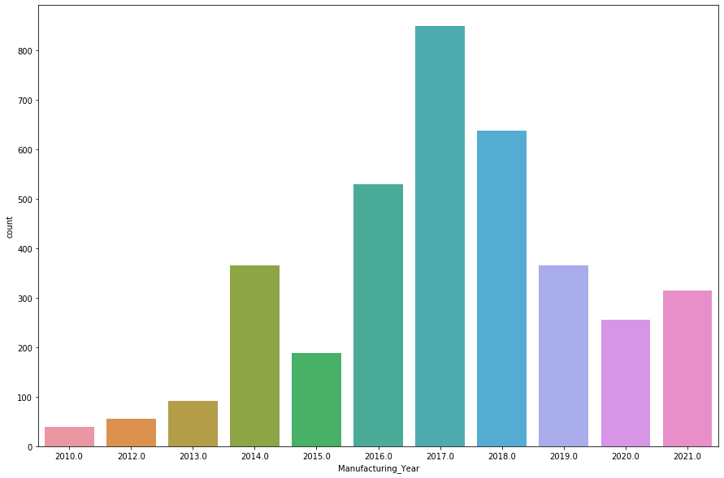
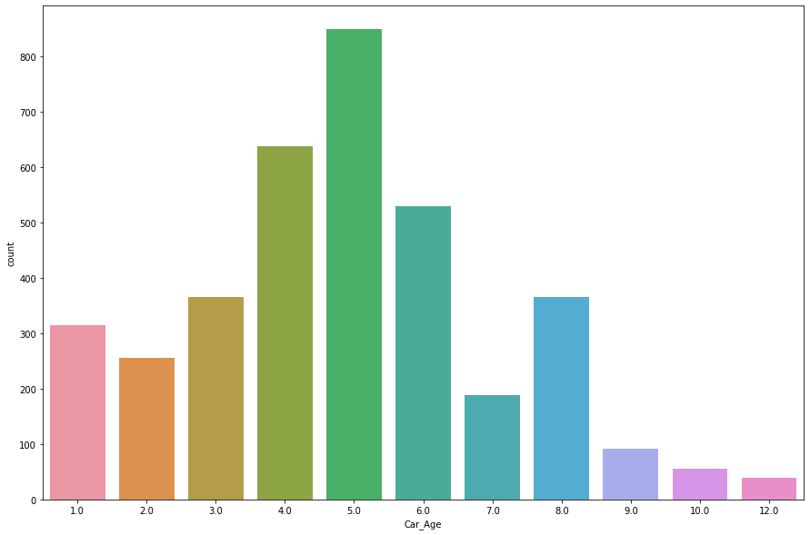
Visualizing the count of Car Age
In Manufacturing year 2017 more car has manufactured, majority of car age is 5 years.

Slide 16
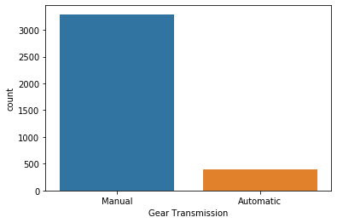
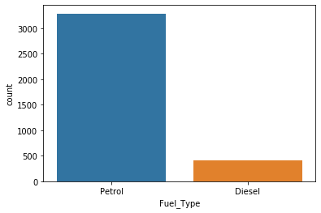
Visualizing the count of Gear Transmission and Fuel Type
In Gear Transmission, majority of car is manual and fuel type is Petrol, this shows that majority of people having the Manual gear not automatic and fuel is petrol.

Slide 17
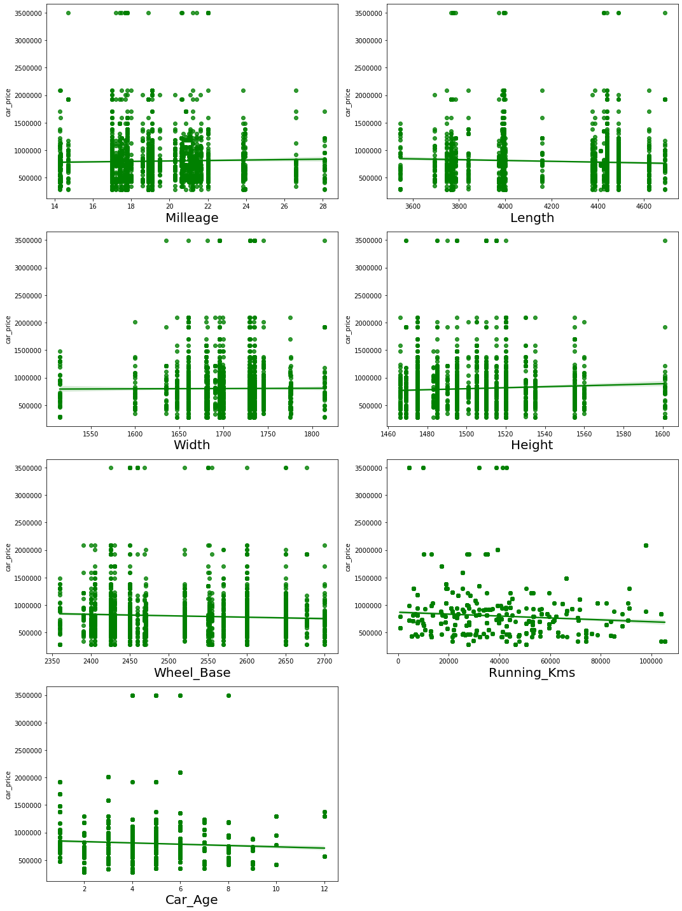
Visualizing the data using the Stripplot

Slide 18

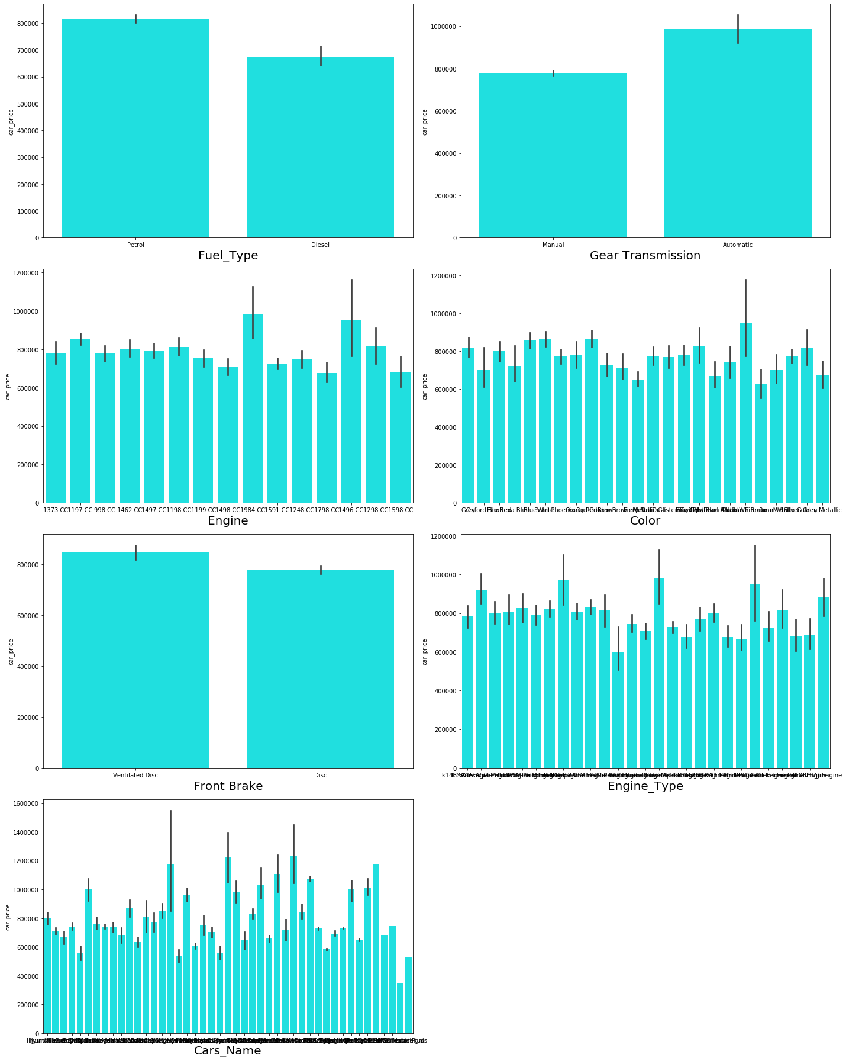
Visualizing the Features Vs Car Price

Slide 19

OBSERVATION
When we compare the fuel type with car price, the diesel fuel type price is high.
The price of Automatic car is high as compare with Manual Gear.
The cars from Rolls-Royce and Aston brand have high price compared to other brands.
A greater number of cars are using Petrol and Diesel fuels and these cars have wide range of price from minimum to maximum.
Most of the cars have seating capacity of 5, 7 and 4 and these cars having higher prices than other cars.
Older cars are having very lower prices when compared to the new cars that is the cars having very less age.
We can conclude that as the car age decrease, then the car price is increases.

Slide 20

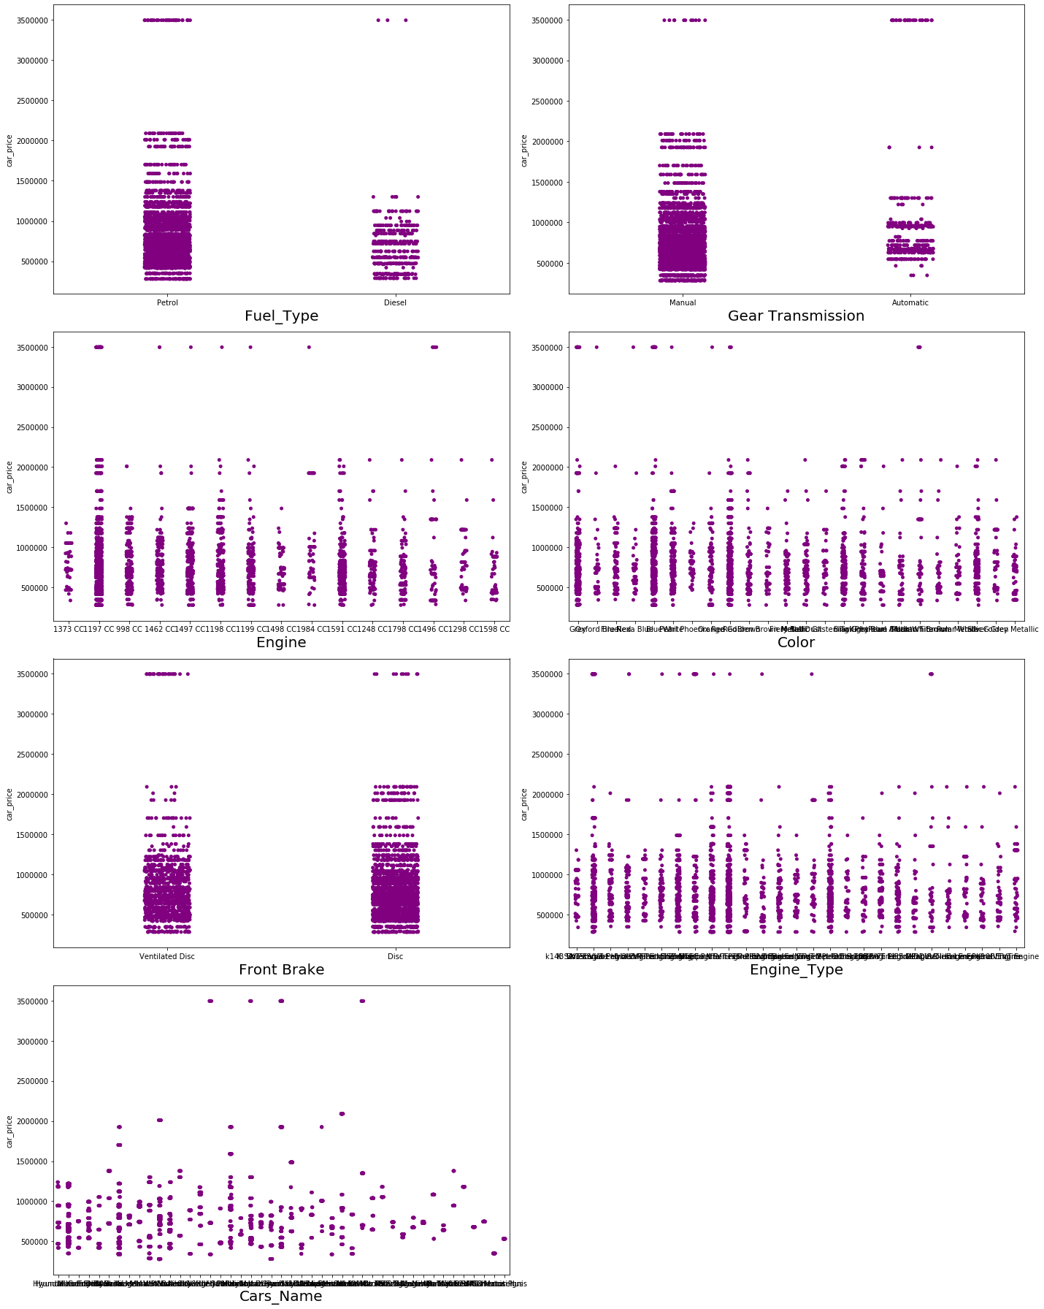
Visualizing the Feature Vs Car Price using the Stripplot

Slide 21

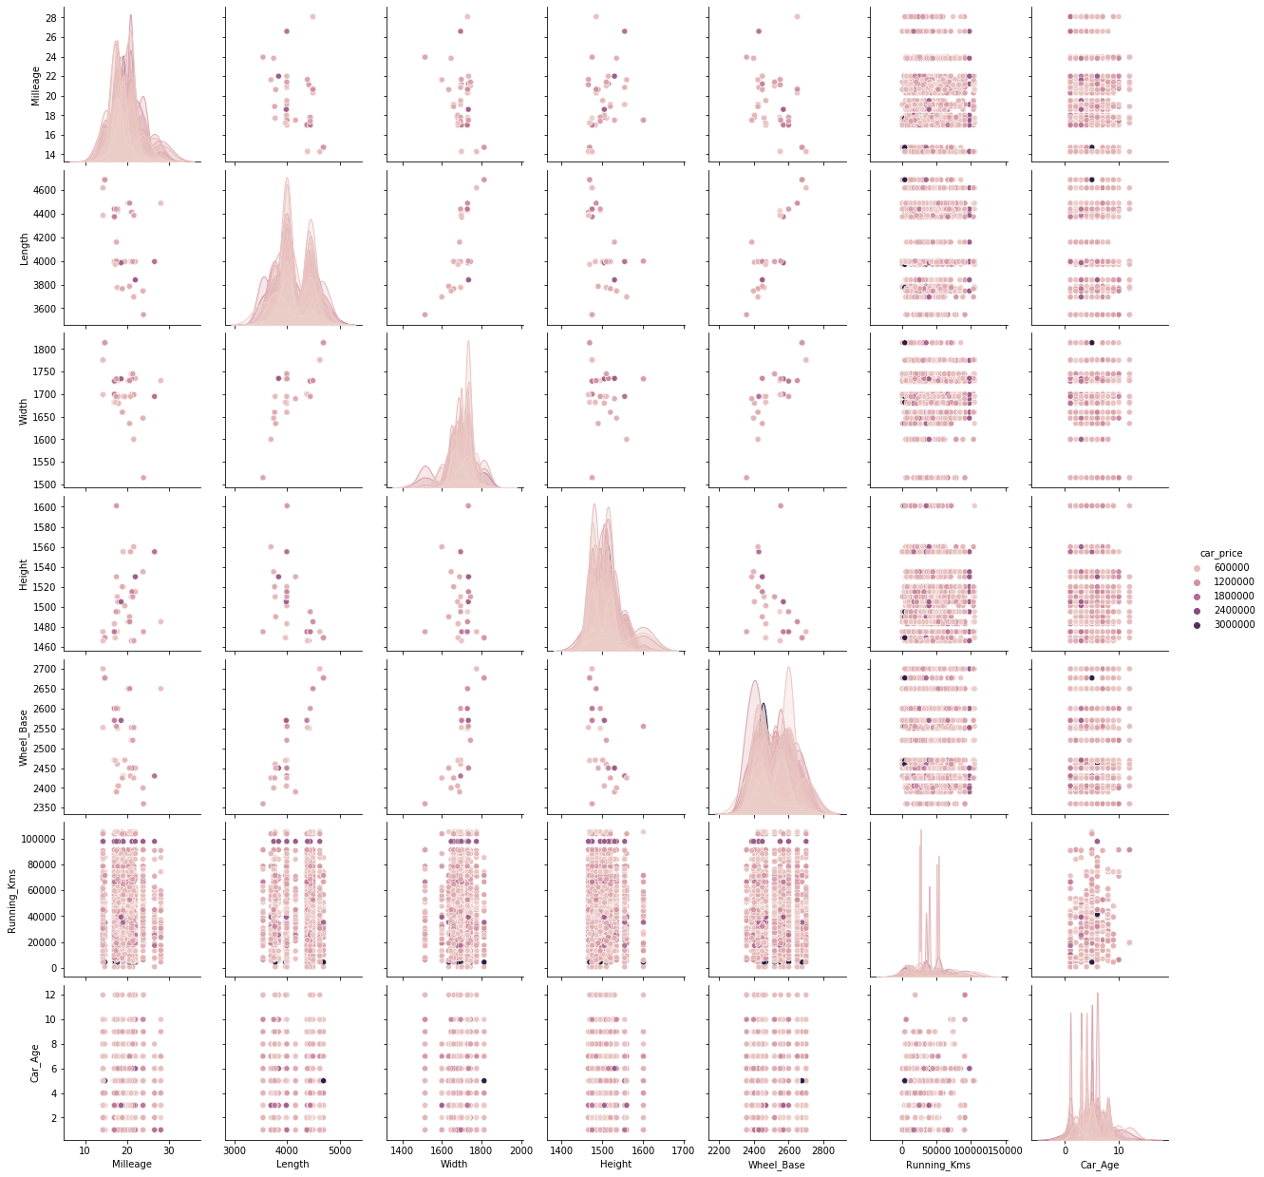
Visualizing the Pairplot with Car Price

Slide 22

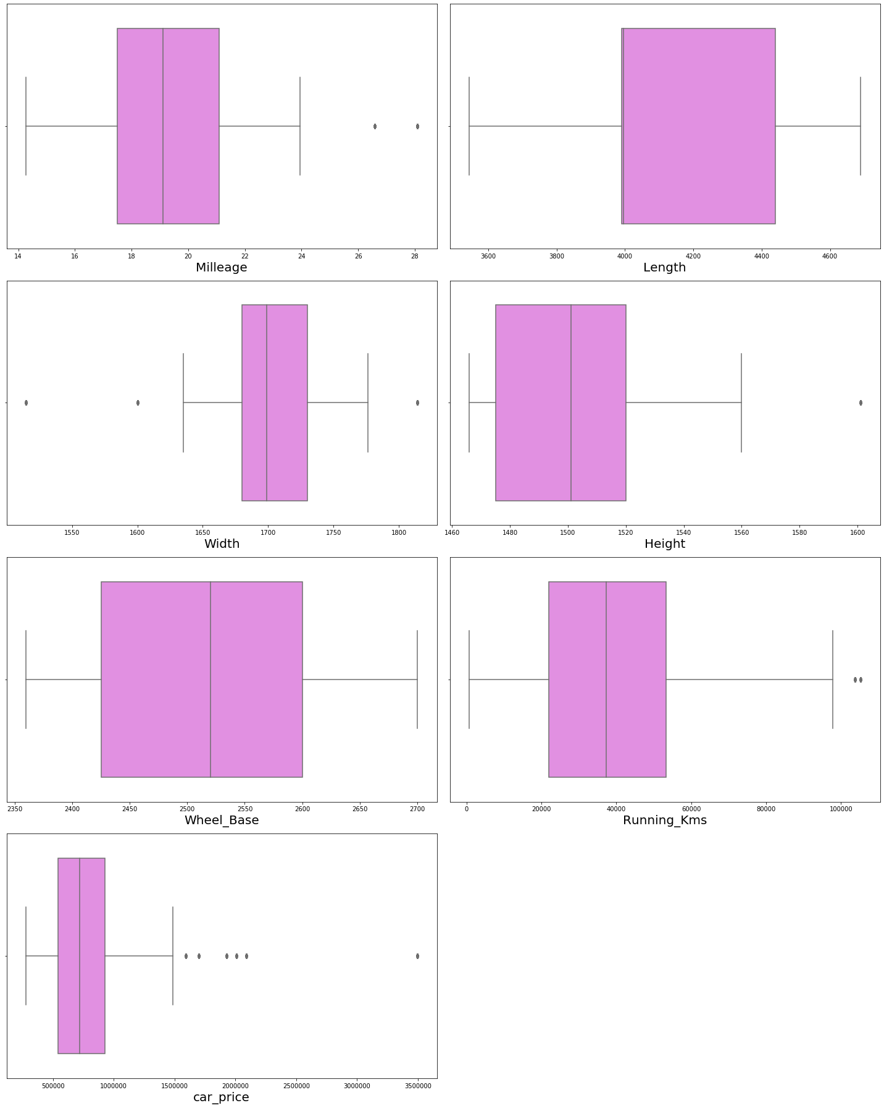
Checking the Outliers using the Box plot
In the box plot we see that is some columns Outliers is present.
Outliers is present in Milleage, Width, Height, Running Kms, Car Price.
As Car Price is target variable, we can ignore it. We removed the Outliers using the zscore method.

Slide 23
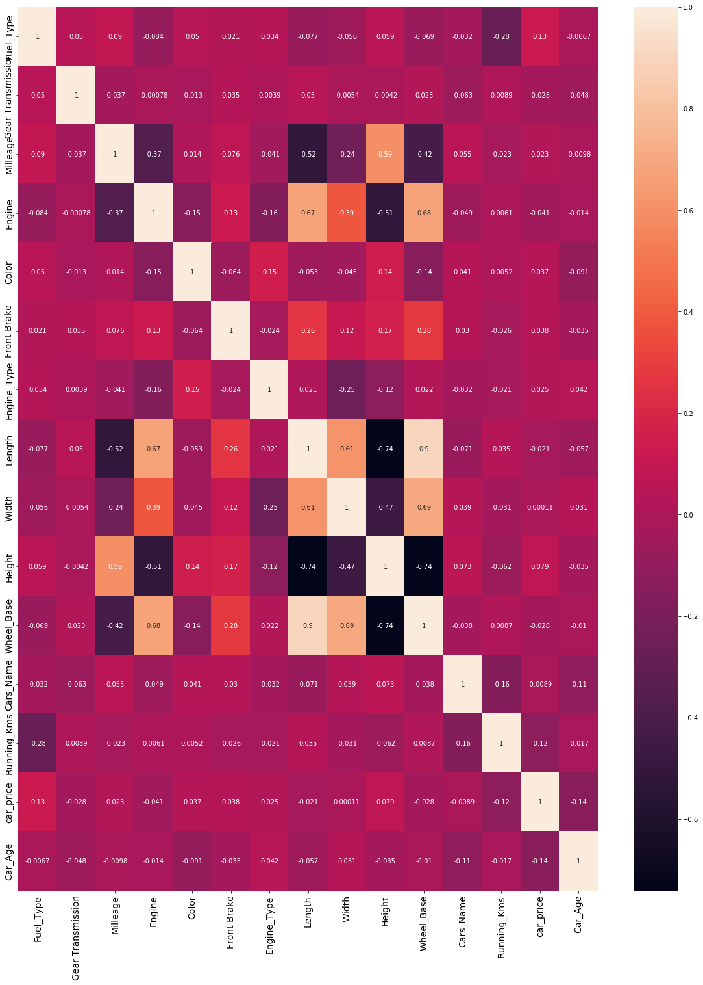
Correlation of Features

Slide 24
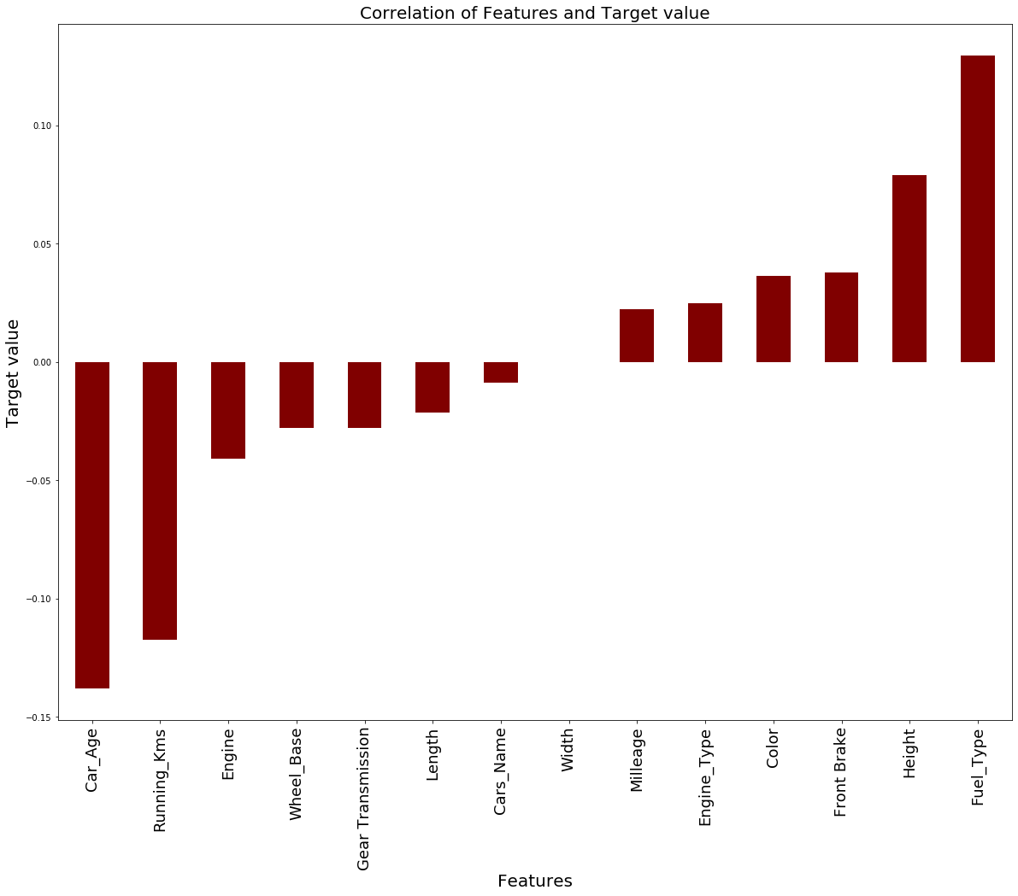
Milleage is less correlated, fuel type is highly correlated. Car Age, Running Kms, Engine, Wheel Base, Gear Transmission, Length is negatively correlated with target variable Car Price

Slide 25

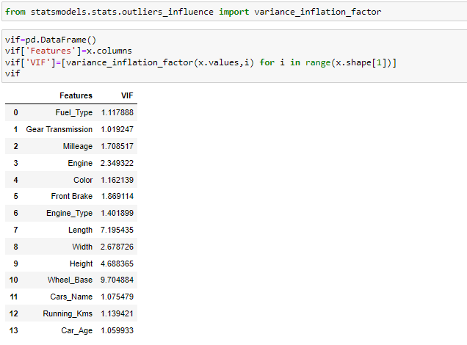
Variation Inflation Factor
As we see there is no high Inflation factor present in the data. It shows that no Multi-collinearity exist.

Slide 26

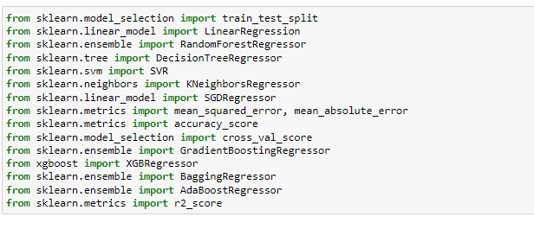
MODEL BUILDING
In this project, Car Price is our target variable, it is continuous. We use the Regression algorithm to build the Machine Learning Model.
The algorithm used in the dataset is:
Random Forest Regressor
Decision Tree Regressor
KNeighbors Regressor
Gradient Boosting Regressor
XGB Regressor
Bagging Regressor
Ada Boost Regressor

Slide 27

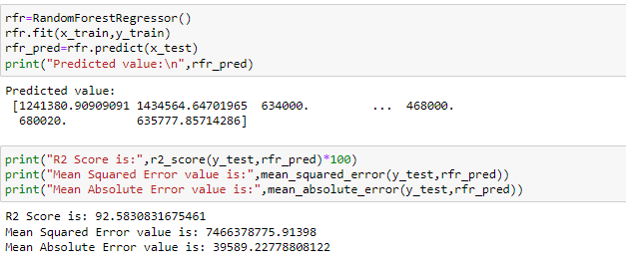
Random Forest Regressor
The Random Forest Regressor model gives the R2 Score 92.5%

Slide 28
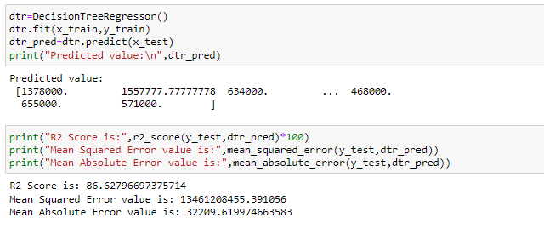
Decision Tree Regressor
The Decision Tree Regressor model gives the R2 Score 86.6%

Slide 29
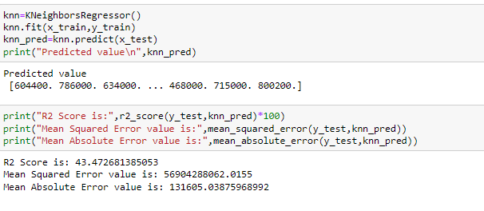
KNeighbors Regressor
The KNeighbors Regressor model gives the R2 Score 43.4%. KNeighbors Regressor didn’t gives the good R2 Score.

Slide 30
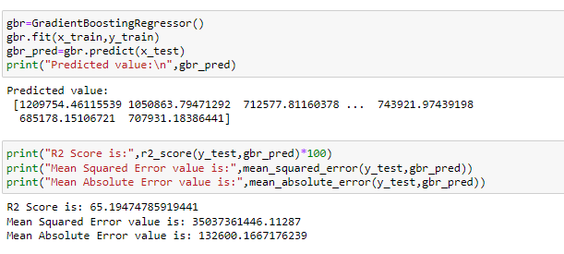
Gradient Boosting Regressor
The Gradient Boosting Regressor model gives the R2 Score 65.1%.

Slide 31
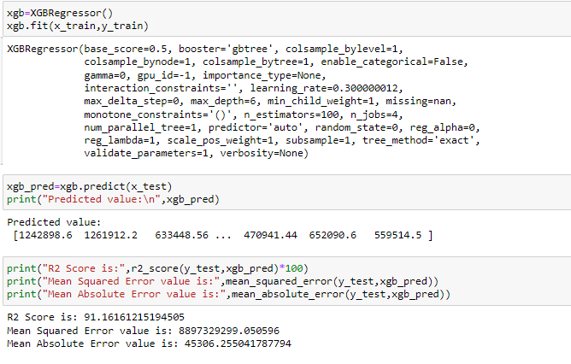
XGB Regressor
The XGB Regressor model gives the R2 Score 91.1%.

Slide 32
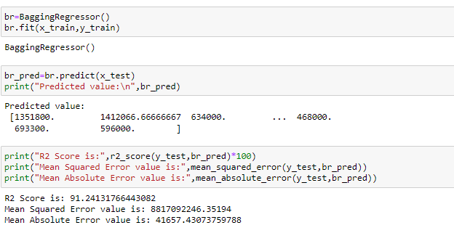
Bagging Regressor
The Bagging Regressor model gives the R2 Score 91.2%.

Slide 33

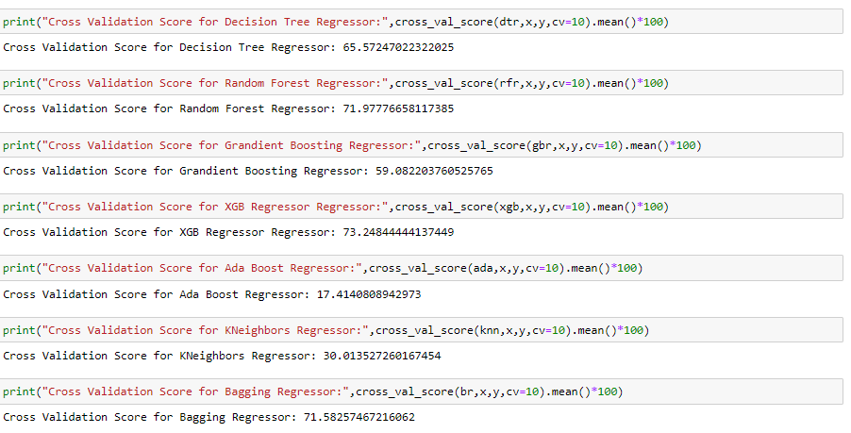
Cross Validation Score
In Cross Validation score, we analyse various machine learning model. Random Forest Regressor gives a good r2 score and cross validation score. So, we will consider Random Forest Regressor as a final model

Slide 34

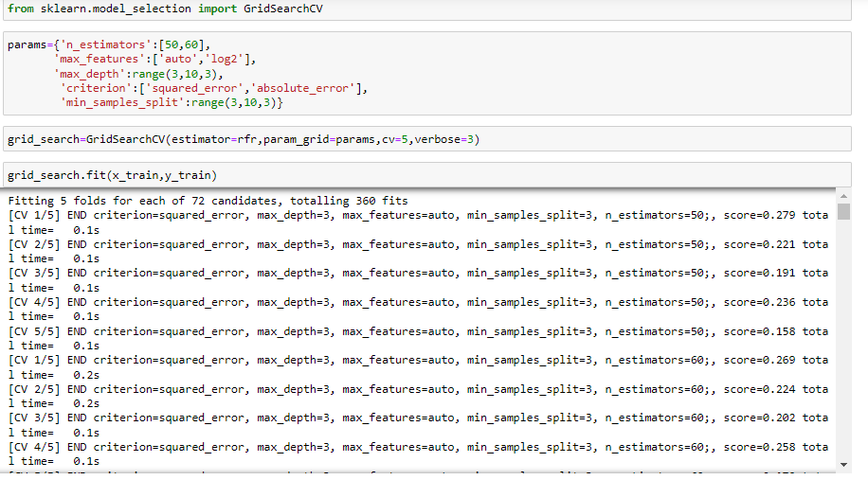
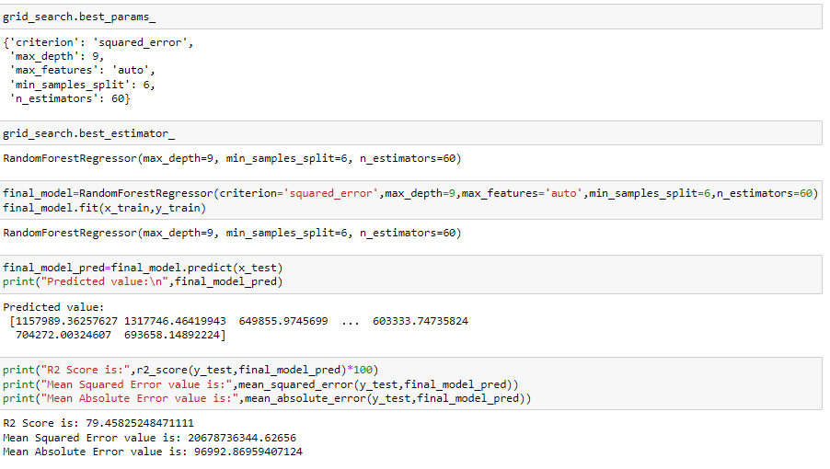
Hyper Parameter Tuning

Slide 35

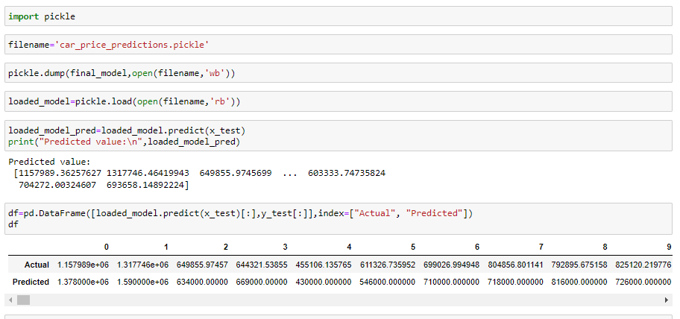
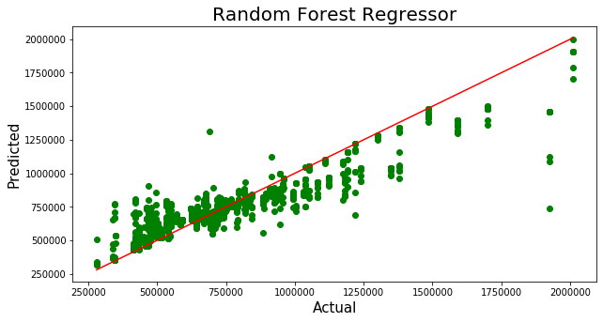
Saving the Model
We have saved our final model using the pickle and plot the actual and predicted value. The plot gives a linear relationship between the actual and predicted value of the car price

Slide 36

CONCLUSION
First I have scrapped the data from cardekho website using the Selenium.
Imported the data in the Jupyter Notebook. We have done the data cleaning, date pre-processing. Removed the Outliers and Skewness from data to avoid any discrepancy in the data. So, that it will not impact in the data accuracy.
Visualized the data using the different visualization plot like dist plot, reg plot, stipplot, violin plot, box plot, kde.
Checked the Variation Inflation factor, scaled the data and build the various machine learning model and checked the r2 score and cross validation of each model.
Then we have done the hyper parameter tuinig to increase the accuracy for our final mode. Finally we have saved the model for future use.
We have predicted the car price, the price of car almost near to the actual car price value. This will help the trader to understand and predicted the care price.

Slide 37

Thank you

